Slide 1
Dissolvable Data
Andy Oh Sean Slavin Baskaran Viswanathan

Slide 2
Where to set up a company?

Slide 3
Quick Facts
USELESS
3 Brains
11 Days
28 hours of brainpower
3 MacBooks
0 Energy Drink
# of Hours Worked on Project
Date | Day | Baskaran | Sean | Andy
9/19 | Tuesday | 3 | 3 | 3
9/20 | Wednesday | 1 | 0 | 1
9/21 | Thursday | 3 | 4 | 3
9/22 | Friday | 0 | 0 | 1
9/23 | Saturday | 4 | 5 | 4
9/24 | Sunday | 2 | 0 | 0
9/25 | Monday | 0 | 2 | 1
9/26 | Tuesday | 4 | 3 | 3
9/27 | Wednesday | 1 | 2 | 1
9/28 | Thursday | 4 | 3 | 3
9/29 | Friday | 4 | 6 | 6
11 Days |  | 26 | 28 | 26

Slide 5
Collaboration Tools

Slide 6
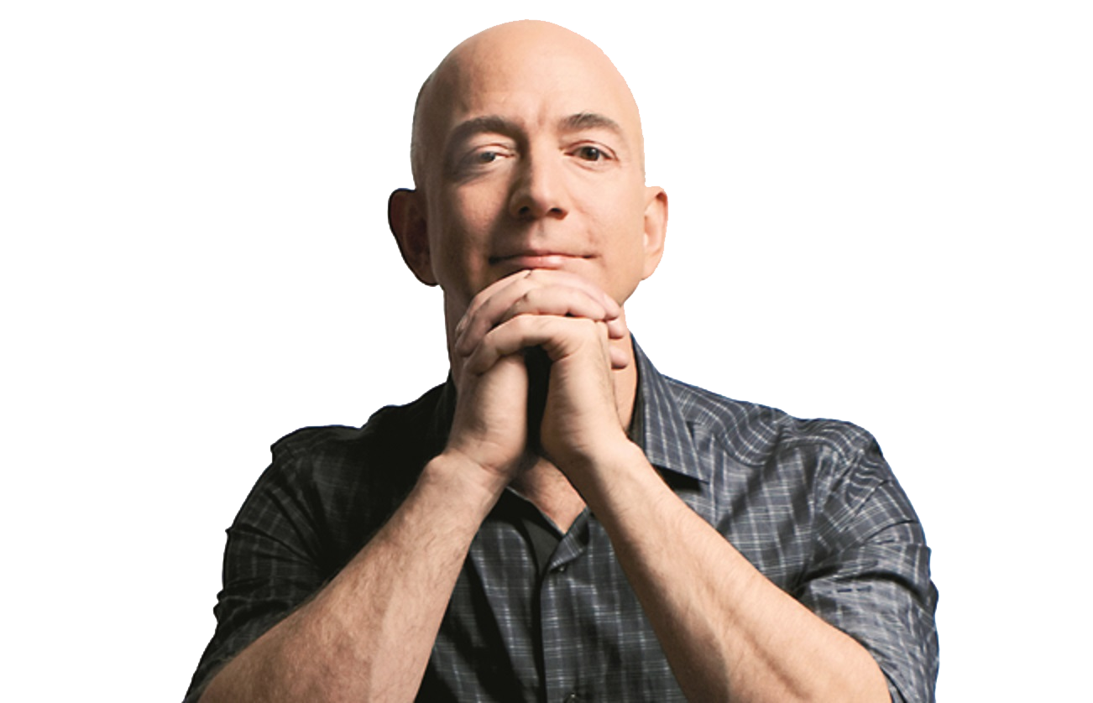
Jeff Bezos
Amazon HQ2
Population ≥ 1,000,000
Major Airport ≤ 45 minutes
City Center ≤ 30 miles
50,000 workers

Slide 7
Data Source
U.S. Census Bureau
https://www.census.gov/data.html
U.S. Bureau of Labor Statistics
https://www.bls.gov/data/#api
OurAirports
http://ourairports.com/data/
Google Map API – Distance Matrix
https://developers.google.com/maps/documentation/distance-matrix/

Slide 8
Process
Census Data
Labor Force Data
Airport Data
Distance Matrix

Slide 9
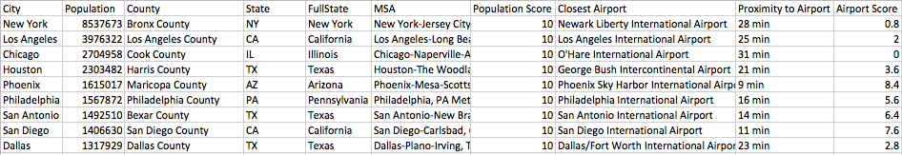
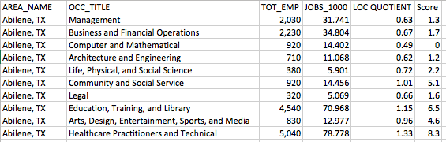
Raw Data
Census Data
Labor Force Data

Slide 12
Code

Slide 13
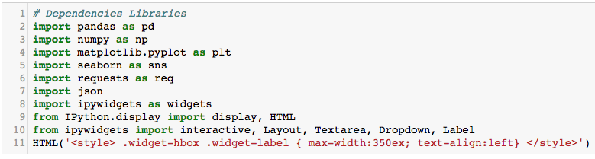

Slide 14
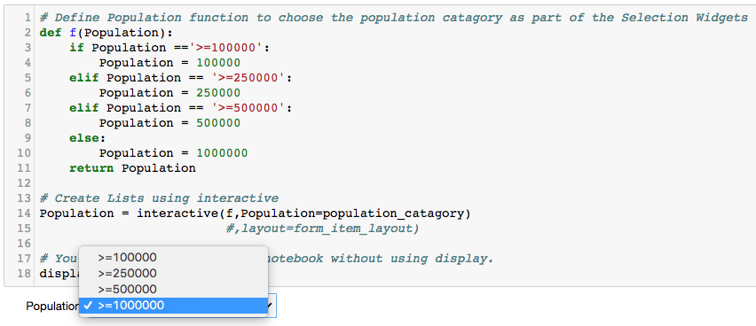

Slide 15
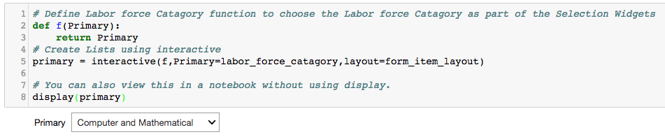

Slide 16
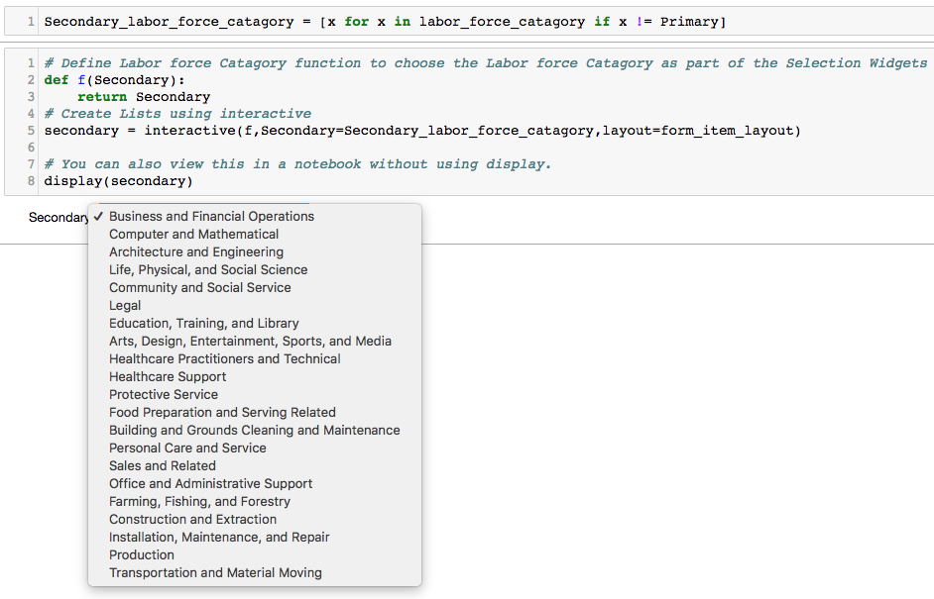

Slide 17
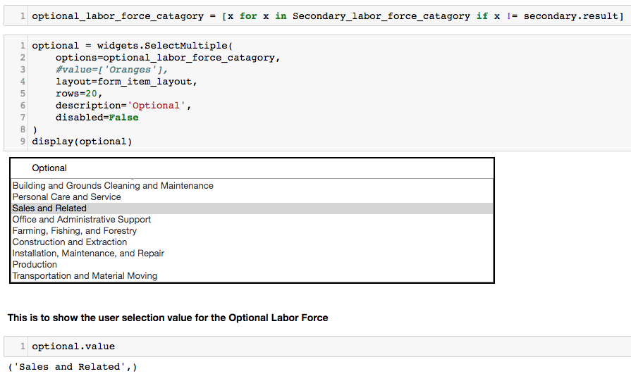

Slide 18
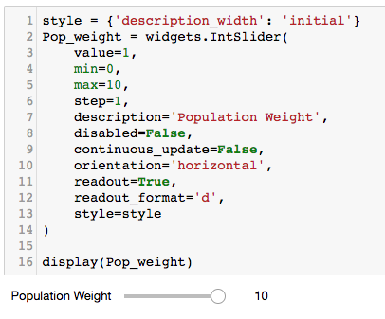
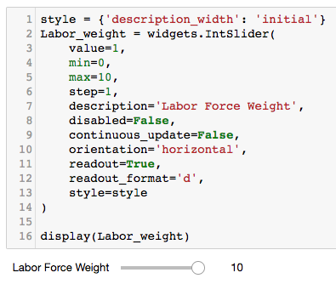

Slide 19
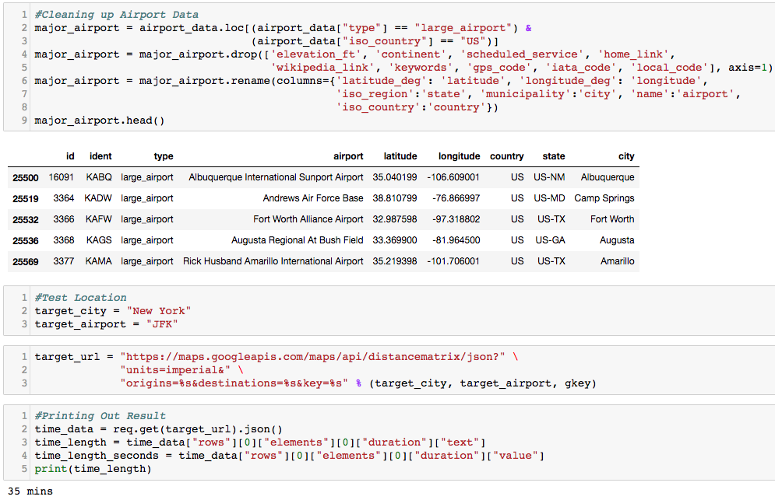

Slide 20
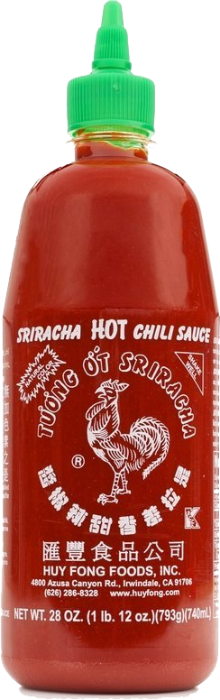
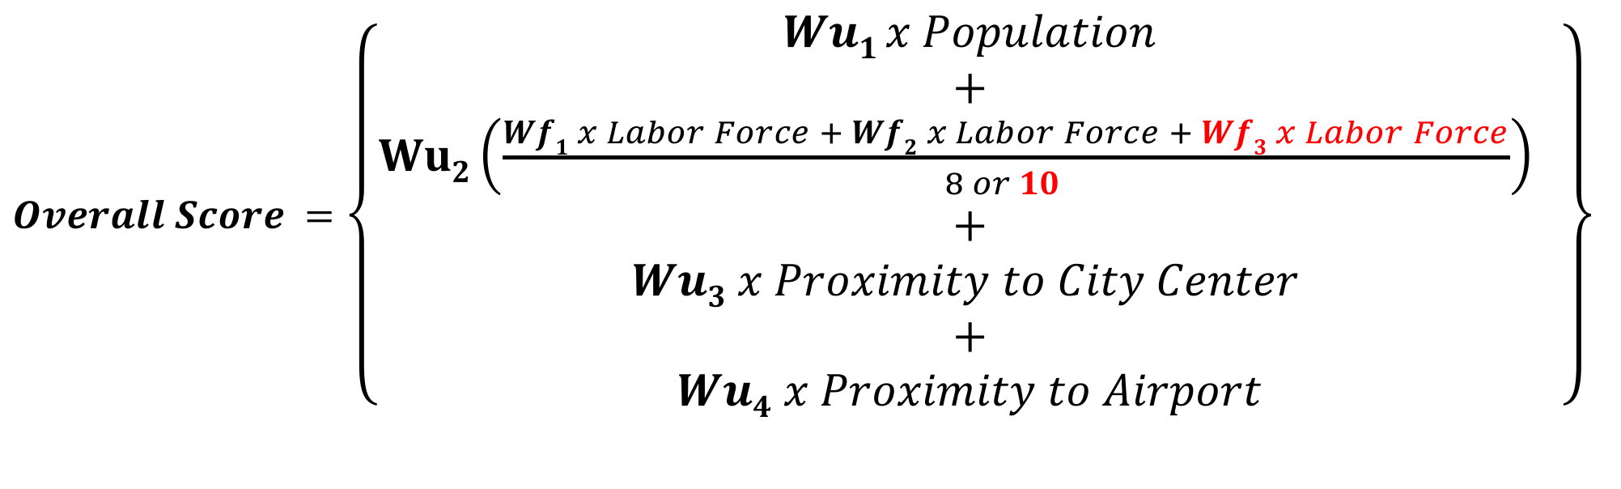
The Secret Sauce
$Overall Score =$ $\left\{\begin{aligned}Wu1 x Population \\ + \\ Wu2\left(\frac{Wf1 x Labor Force + Wf2 x Labor Force + Wf3 x Labor Force}{8 or 10 }\right) \\ + \\ Wu3 x Proximity to City Center \\ + \\ Wu4 x Proximity to Airport\end{aligned}\right\}$
Wu_{1…4} and Wf_{1…3} are weighted values

Slide 21
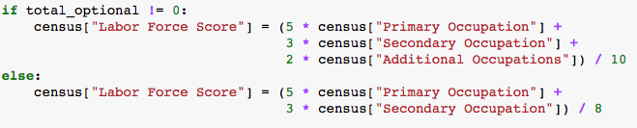
Secret Sauce in Code

Slide 22
Result – Amazon HQ2

Slide 23
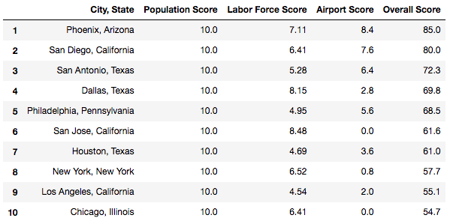

Slide 24
textio
MarketWatch

Slide 25
Quartz
Brookings Institution

Slide 26

Result Comparisons
Dissolvable Data
# | City
1 | Phoenix
2 | San Diego
3 | San Antonio
4 | Dallas
5 | Philadelphia
Bloomberg
# | City
1 | Toronto
2 | Boston
3 | Washington
4 | Atlanta
5 | Dallas
Quartz
# | City
1 | Salt Lake City
2 | Denver
3 | Boston
4 | Raleigh
5 | Washington DC
MarketWatch
# | City
 | Atlanta
 | Austin
 | Baltimore
 | Boston
 | Bridgeport
CityLab
# | City
1 | Chicago
2 | Dallas
3 | Philadelphia
4 | Atlanta
5 | Phoenix
Textio
# | City
1 | Birmingham
2 | Grand Rapids
3 | Montreal
4 | Salt Lake City
5 | New Orleans

Slide 27
Not bad, right?

Slide 28
Dissolvable Data Company

Slide 30
Wish List
Accuracy would be greatly improved if we use:
Commercial Real Estate Data
Mass Transit Data
Community Fit/Cultural Diversity Data

Slide 31
Challenge

Slide 32
Questions? Comments?

